Slide 1
From VS Code
to GitHub Pages
WEB DEVELOPMENT LAB · WORKSHOP
Set up your tools, meet Copilot, and publish your own portfolio website
ANUSHKA BHALERAO
Notes:
Welcome everyone. Today we set up the tools real developers use, and by the end you will know exactly how to put your own website on the internet for free. The address at the bottom is what you will submit as your assignment.

Slide 2
Four goals, one finished website
TODAY’S PLAN
01
02
03
04
Set up VS Code
Connect to GitHub
Turn on Copilot
Build a portfolio
Install the editor, learn its layout and create your first file.
Create an account, install Git and save your work online.
Activate the free plan and learn to use an AI pair programmer responsibly.
See two examples, then build and host your own page as the assignment.
Notes:
Each goal builds on the last. We cannot use Copilot without GitHub, and we cannot publish without Git. The fourth card is dark on purpose: that is the assignment, which you complete at home.

Slide 3



Your own website, with your own address
WHERE WE ARE HEADING
https://priya-sharma.github.io
By the end you will have
A working setup: VS Code, Git, GitHub and Copilot
A repository that stores every version of your code
A public link you can share with recruiters
priya.dev
About Skills Projects Contact
Hi, I’m Priya Sharma.
Student developer learning HTML, CSS and JavaScript.
HTML
CSS
JavaScript
Notes:
Show the finished outcome first so students know what they are working toward. Point to the address bar: the part before .github.io is their GitHub username, so ask them to choose a professional one.

Slide 4
Setting up VS Code
01
The editor where you will write every line of your website
Notes:
Part one. Visual Studio Code is a free code editor from Microsoft. It is the most widely used editor among web developers, and it is where Copilot will live.

Slide 5
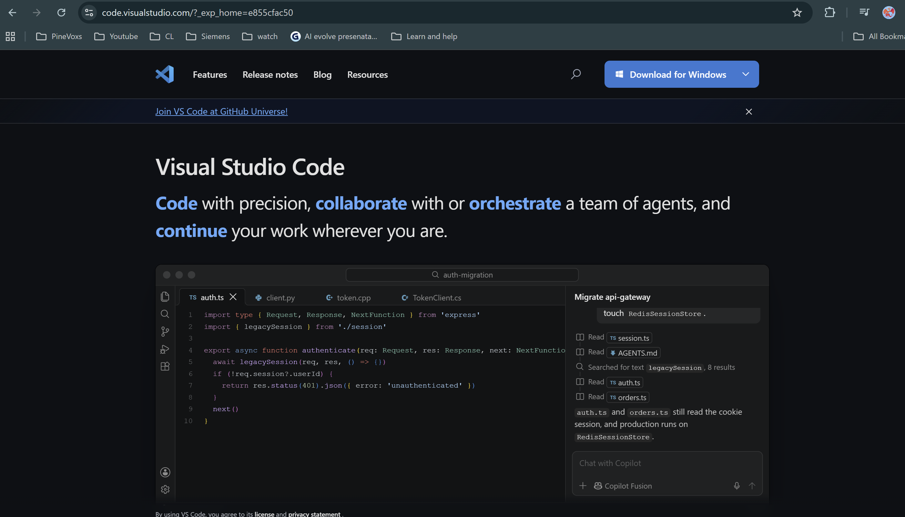
Download and install VS Code
STEP 1 · INSTALL
Open code.visualstudio.com in your browser
Click the download button for your system (Windows, macOS or Linux)
Run the installer. On Windows, tick Add to PATH and Add “Open with Code”
Launch VS Code and pick a colour theme
Notes:
Illustration of the download page, simplified. Do this live on the projector. Remind students to download only from the official site. The two Windows checkboxes let them type "code ." in a terminal and right-click a folder to open it in VS Code.

Slide 6







Five areas of the VS Code window
STEP 2 · FIND YOUR WAY AROUND
index.html — portfolio — Visual Studio Code
Activity Bar: switch between Explorer, Search, Source Control and Extensions
Side Bar: your project’s files and folders
Editor: where you type code
Panel: the Terminal, opened with Ctrl + `
Status Bar: branch, cursor position and Copilot status
1
2
EXPLORER
3
Editor
▾ portfolio
<h1>Hi, I’m Priya</h1>
index.html
<p>Student developer</p>
<section id="skills">
style.css
script.js
4
TERMINAL
C:\Users\priya\portfolio> git status
5
main · Ln 12, Col 5 · HTML
Notes:
A simplified drawing of the VS Code window. Open the real thing next to it and point to each numbered area. The Command Palette (Ctrl+Shift+P, or Cmd+Shift+P on Mac) is worth mentioning: almost every action can be found there by typing its name.

Slide 7
Create a project and preview it live
STEP 3 · YOUR FIRST FILE
Make a folder called portfolio
File › Open Folder and choose it
New file: index.html
Type ! and press Enter to get the HTML skeleton
In Extensions (Ctrl+Shift+X), install Live Server
Right-click the file › Open with Live Server
index.html
<!DOCTYPE html>
<html lang="en">
<head>
<meta charset="UTF-8">
<title>Priya Sharma</title>
<link rel="stylesheet" href="style.css">
</head>
<body>
<h1>Hello, world!</h1>
<script src="script.js"></script>
</body>
</html>
Notes:
The exclamation mark shortcut is called Emmet and is built into VS Code. Live Server reloads the browser every time you save, which makes learning CSS much faster. Point out the two links to style.css and script.js: that is how the three files of the portfolio connect.

Slide 8
Connecting to GitHub
02
Git keeps the history. GitHub keeps it online.
Notes:
Part two. Make the distinction clear from the start: Git is a program on your computer that tracks changes; GitHub is a website that stores Git projects online and lets others see them. GitHub Pages is a feature of GitHub that turns a repository into a website.

Slide 9
Account, Git, and your identity
BEFORE WE CONNECT
1. Create a GitHub account
TERMINAL
PROBLEMS
OUTPUT
Sign up at github.com/signup. Choose a professional username: it becomes your website address.
$ git --version
git version 2.x.x
2. Install Git
$ git config --global user.name "Priya Sharma"
Download from git-scm.com and keep the default options. macOS users can run xcode-select --install.
$ git config --global user.email "priya@example.com"
Or use your GitHub noreply email to keep it private.
3. Tell Git who you are
Run the three commands on the right in the VS Code terminal.
Notes:
If git --version gives "not recognized", Git is not installed or VS Code was open during installation: close and reopen VS Code. The name and email are attached to every commit, so they must match the GitHub account for commits to show on the student's profile.

Slide 10
Stay safe: your site is public
BEFORE YOU START
OK
STOP
Fine to share
Never publish
Your first name or a display name
Your skills, projects and learning goals
A link to your GitHub profile
A photo or email, only if you and a parent/guardian agree
Passwords, API keys or tokens
Home address or phone number
Your exact daily schedule
Private information about anyone else
!
GitHub requires you to be at least 13. If you are not, talk to your instructor and a parent/guardian about an approved alternative. Never sign up with a false age.
@
Want your email private? Use your GitHub noreply address in git config user.email. Check screenshots for private details too.

Slide 11




Sign in to GitHub from VS Code
LINK THE TWO
Sign in with GitHub to use GitHub Copilot
Authorize Visual Studio Code
Click Accounts
Choose GitHub
Authorize
Back in VS Code
The person icon at the bottom of the Activity Bar
VS Code opens your browser
Log in on github.com and approve
Your username shows under Accounts
Notes:
If the browser asks "Open Visual Studio Code?", click Open. On shared lab computers, remind students to sign out of both GitHub and VS Code at the end of class.

Slide 12

Setting up Copilot in four clicks
TURN IT ON
Make sure you are signed in to GitHub in VS Code
Click the Copilot icon in the title bar or Status Bar
Choose Set up Copilot, then accept the free plan in the browser
Open Chat with Ctrl+Alt+I (Mac: Ctrl+Cmd+I)
portfolio — Visual Studio Code
Copilot
Use Copilot for free
Code completions and chat, with a monthly limit.
Set up Copilot
Ln 1, Col 1 HTML
VS Code → GitHub Pages · 15
Notes:
Simplified illustration; button wording can vary slightly between VS Code versions. Recent versions of VS Code include Copilot built in, so there is usually nothing to install: signing in and choosing the free plan is enough. If a student does not see the icon, open Extensions and install GitHub Copilot Chat.

Slide 13
Six Git words you will use every day
SPEAK THE LANGUAGE
Term | What it means | Think of it as
Repository | A project folder whose history Git tracks | A binder for one project
Commit | A saved snapshot, with a short message | A dated photo of your work
Branch | A line of work; ours is called main | A timeline of snapshots
Remote | The copy of the repository on GitHub | Your cloud backup
Push | Send your commits up to GitHub | Upload
Pull | Bring changes from GitHub down to you | Download
Notes:
Keep this light. Students will see these words as buttons in VS Code on the next slide. A good commit message describes what changed, for example "Add projects section", not "update".

Slide 14
Create, clone, and add four files
PART 1 · SET UP YOUR REPOSITORY
1
Create a public repo on github.com
File | Its job
index.html | Home page and all portfolio content
style.css | Colours, spacing, fonts and layout
README.md | Description, live link, how to preview locally
learning_log.md | Copilot log, test notes, reflection
Name it exactly username.github.io
2
Tick Add a README file, then create it
This gives you something to clone.
3
In VS Code: Ctrl+Shift+P › Git: Clone
Paste the repository URL and choose a local folder.
4
Open the cloned folder and create the files
Already have a username.github.io repository? Improve that portfolio instead of starting a new one.
Every file goes in the top-level folder.

Slide 15

Save, commit and publish with Source Control
THE EVERYDAY WORKFLOW
1
Clone your repo once: Ctrl+Shift+P › Git: Clone.
SOURCE CONTROL
Add about and skills sections
2
Stage files with +. M means modified, U means new.
Commit
▾ Changes 3
3
Write a clear message and click Commit.
index.html
M +
4
Sync Changes (push) after each commit; Pull when you start.
style.css
U +
README.md
U +
Sync Changes
Notes:
Illustration of the Source Control panel. Demo live: make a small change, show the M badge, stage, commit, then publish. When publishing, VS Code asks public or private. For GitHub Pages on a free account the repository must be public, which we will cover in part four.

Slide 16
Three meaningful commits, and one pull
PART 1 · HABITS THAT EARN POINTS
Your commit history should tell the story
Pull at the start of each session
Create portfolio structure
First commit
Open the Source Control view, then … › Pull (or Sync Changes).
Pull downloads changes from GitHub. Push uploads your commits.
Add project showcase and styling
Real progress
Fix navigation and improve mobile layout
After first deploy
Evidence you will submit
Avoid messages like update or stuff. Each commit should show visible progress.
A screenshot of the project open in VS Code
A link to the repository's commit history

Slide 17
GitHub Copilot, free
03
An AI pair programmer inside your editor
Notes:
Part three. Copilot suggests code as you type and answers questions in a chat panel. It is a helper, not a replacement for understanding. We will set it up today; students use it for the assignment at home.

Slide 18

Inline suggestions and chat
TWO WAYS TO WORK WITH IT
As you type
Copilot Chat
<!-- three project cards -->
Explain what display: flex does in my style.css
<div class="projects">
<article class="card">
Flexbox lays out the children of an element in a row or column…
<h3>Calculator</h3>
Why is my navigation not centred?
</article>
Tab accepts the grey text. Esc dismisses it.
Ask it to explain and fix, not just to write.
Rule of the class: never accept code you cannot explain. You will be asked about your own page.
Notes:
Demo: type the comment, wait for the grey suggestion, press Tab. Then open chat and ask it to explain a CSS property. Stress that Copilot can be wrong, and that the goal of the assignment is to learn HTML, CSS and JavaScript, with Copilot as a tutor beside you.

Slide 19
Three purposeful Copilot interactions
PART 3 · YOUR COPILOT TASKS
Type | What to ask for | Example prompt you can adapt
1 Build | Help creating or improving one small part of the site | Help me create a beginner-friendly HTML structure for a student portfolio with About Me, Skills and Projects. Use placeholders instead of inventing facts about me.
2 Understand | An explanation of some HTML or CSS | Explain how the navigation links connect to section IDs in my HTML.
3 Improve / fix | Fix a bug, improve readability, or make it work on mobile | My project cards overflow on a narrow screen. Help me find the CSS causing this and explain a simple fix.
!
Use Copilot inside VS Code, and record all three in learning_log.md (next slide).

Slide 20
Keep a learning log
PART 3 · DOCUMENT YOUR LEARNING
Prompt or question | What Copilot suggested | Accepted, changed or rejected? | How I checked it
Your exact prompt | A short summary | Your decision, and why | A test or observation
Reflection: 150–250 words
AI ground rules
How do GitHub, VS Code, Copilot and GitHub Pages each help you build?
One challenge, and how you solved it
One piece of code you can now explain
What you would improve next
Read every suggestion, personalise it, test it
Be ready to explain your files and make a small edit live
No unchanged AI site; no copying a classmate
Credit templates, tutorials and borrowed assets in README

Slide 21
Your portfolio page
04
HTML for structure, CSS for style, JavaScript for behaviour
Notes:
Part four. Everything so far was setup. Now we look at what a portfolio contains, see two examples, and then publish with GitHub Pages. PHP and MySQL come later in the course; this page needs none of that.

Slide 22
The anatomy of a portfolio page
PLAN BEFORE YOU CODE
<nav>
Section | What goes in it
Navigation | Links that jump to each section
Welcome + About | Display name, headline, a short paragraph about you
Skills | At least four skills or tools, described honestly
Projects | At least two; one Python or data science
Learning goals | What you’ll learn next, or how you’ll help others
Footer | Link to your GitHub profile (email optional)
<header> welcome · about
<section> skills · projects
card
card
card
<section> goals
<footer>
Notes:
The wireframe on the left uses the real HTML tag names. Encourage students to sketch their own layout on paper before opening VS Code. If they have no projects yet, class exercises count.

Slide 23
Every project entry needs four things
PART 2 · PROJECTS
01
02
03
04
Title and purpose
Tools used
What you learned
A working link
What problem does it solve, or why did you build it?
For example Python, pandas, matplotlib, HTML, CSS
Or what you contributed, in your own words
Code, notebook, demo or other artifact the instructor can open
!
At least two projects; at least one Python or data science project. Your portfolio itself can be the second.
i
GitHub Pages only hosts static files and cannot run Python. Link to your notebook or repository. Private repo? Give your instructor access.

Slide 24
How the page is put together
THREE FILES, THREE JOBS
index.html
style.css
script.js
Structure
Style
Behaviour
What is on the page
How it looks
Optional: what it does when you click
<section id="skills">
.projects {
btn.addEventListener(
<h2>Skills</h2>
display: grid;
"click", () => {
<li>HTML</li>
gap: 16px;
alert("Hello!");
</section>
}
});
Notes:
A house analogy works well: HTML is the walls and rooms, CSS is the paint and furniture, JavaScript is the electricity. Keep the three in separate files, linked from index.html as shown on the first-file slide.

Slide 25
Make it readable for everyone
PART 2 · DESIGN AND USABILITY
✓
Navigation that works · Links like #projects jump to matching section ids
✓
Your own style.css · Linked from index.html and personalised
✓
Desktop and mobile · Readable at a narrow, phone-sized width
✓
Clear and readable · Headings, font size and strong text contrast
✓
Meaningful link text · “My data project”, not “click here”
✓
Images done right · Alt text, and only images you may use
✓
No placeholders · Remove sample text and check spelling
✓
GitHub profile link · A working link to github.com/username
Scope: plain HTML and CSS are enough. JavaScript is optional. No custom domain, database or contact form needed.

Slide 26
Examples
https://anushka05012.github.io/
https://eshaandhavala.github.io/
VS Code → GitHub Pages · 22
Notes:
Do this live if time allows, or show prompt 1 only. The point is the rhythm: small prompt, read the result, change it, commit. Five prompts uses five of the fifty monthly chat requests, so students have plenty left for questions.

Slide 27
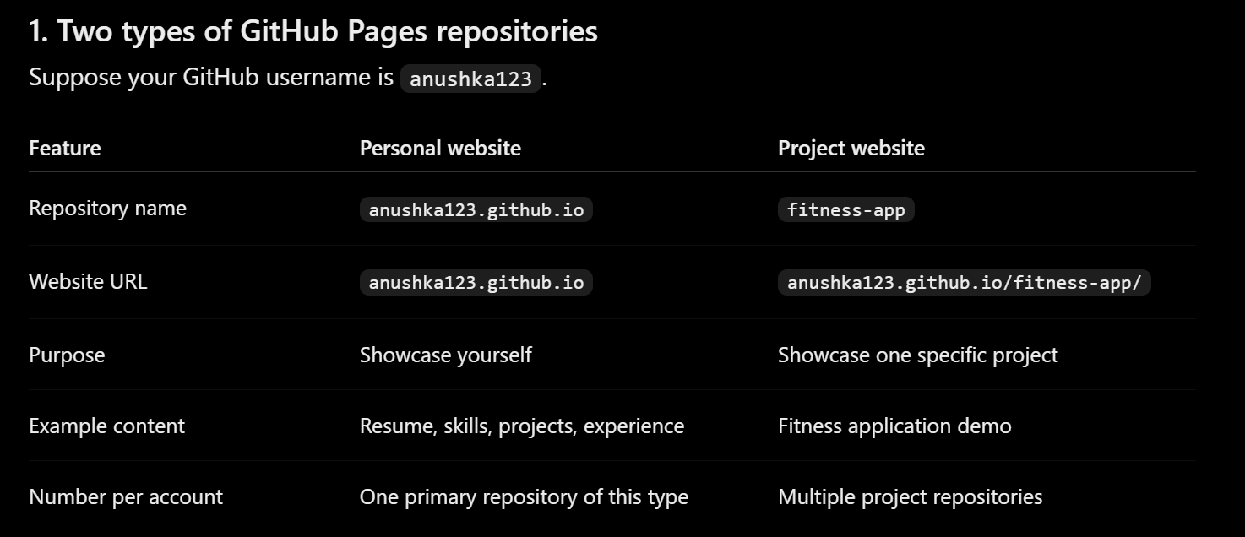
Host it free with GitHub Pages
GO LIVE
Create a public repository named exactly username.github.io
Push your files. index.html must sit at the top level
Open Settings › Pages
Source: Deploy from a branch. Branch: main, folder / (root). Save
Visit https://username.github.io. Allow up to 10 minutes
Notes:
Simplified illustration of the repository's Settings › Pages screen. The repository name must match the username exactly, including lowercase. If a student already published under a different repository name, they can rename it on GitHub under Settings › General. GitHub notes that changes can take up to ten minutes to appear after a push.

Slide 28
Prove the update, then test everything
PART 4 · TEST
After the first deploy
Test checklist · record results in learning_log.md
1
Make one improvement in VS Code
Live URL opens in a private/incognito window
Commit and push it
All required sections hold your own content
2
Navigation, GitHub profile and project links work
3
Confirm the live site changed
Readable on desktop and at a narrow width
Images (if any) load and have alt text
This can be one of your three commits. Deployment failing? Check the repository’s Actions tab.
Your latest change shows on the live site
No private info on the site, repo or screenshots

Slide 29
Common problems and quick fixes
WHEN SOMETHING GOES WRONG
You see | Try this
404 on your github.io link | Check repo name, Pages branch/folder, index.html at top level, Actions tab
Page has no styling | Check href="style.css": names are case-sensitive online
Changes not showing | Did you push? Wait a few minutes, then refresh with Ctrl+F5
git is not recognized | Install Git, then restart VS Code
Push rejected | Pull or Sync first, then push again
Copilot does not respond | Check sign-in and monthly limit; still blocked? Tell your instructor
Notes:
Case sensitivity catches many students: Windows treats Style.css and style.css as the same file, but GitHub Pages does not. Also check that images are inside the repository and referenced with relative paths, not C:\Users\... paths.

Slide 30
What to hand in
PART 4 · SUBMIT
1
Live portfolio URL
https://username.github.io/
README.md must include
A short project description
The live website link
How to preview locally (open index.html)
Credits for templates or borrowed assets
2
Source repository URL
github.com/username/username.github.io
3
Commit history URL
Commits page of your repository
4
Learning log link
learning_log.md in your repository
Improving an existing portfolio? Summarise what is new in the learning log and name the assignment commits. Submit through your instructor’s submission channel.
5
Two screenshots
Project open in VS Code · live site in a browser

Slide 31
Questions?
Then go build something that is yours.
Editor
Version control
code.visualstudio.com
git-scm.com
Hosting guide
Student benefits
docs.github.com/pages
education.github.com
Notes:
Leave the resource links on screen while taking questions. Remind students of the due date and to apply for the GitHub Education student offer early.

